Slide 1
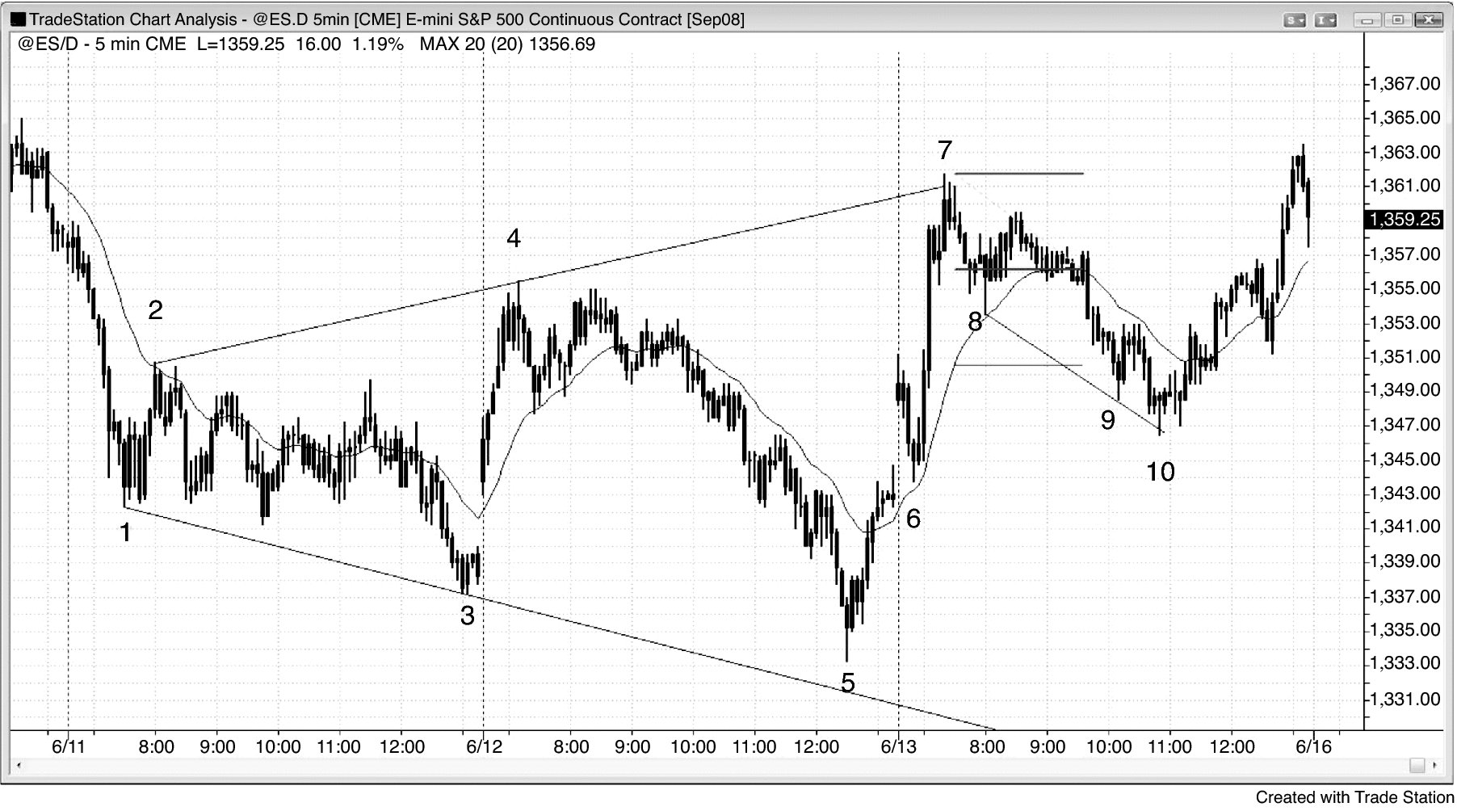
FIGURE 6.1 Expanding Triangle Bottom in the Emini

Slide 2
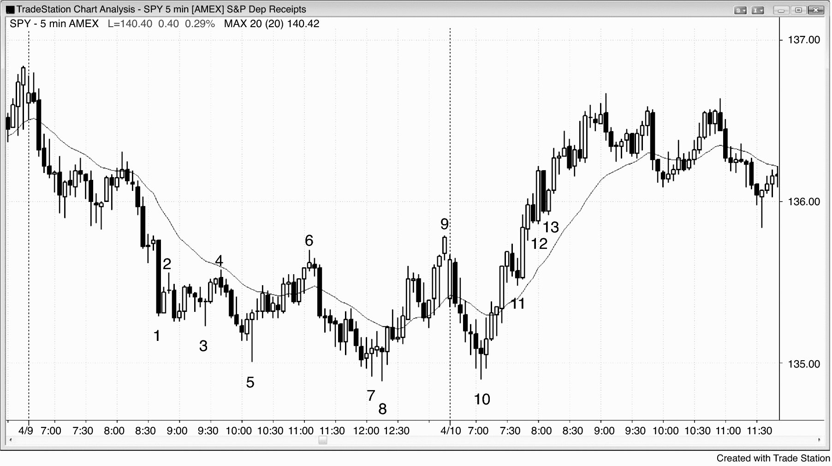
FIGURE 6.2 Expanding Triangle Bottom Reversal

Slide 3
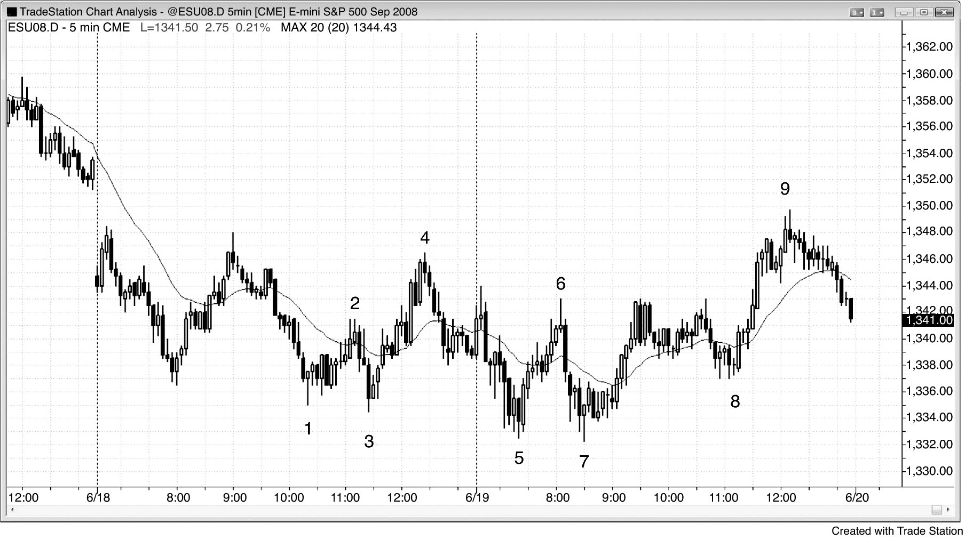
FIGURE 6.3 Second Entry in Expanding Triangle Reversal

